Slide 1

Your Logo Here
WELCOME!
Investing in Georgia’s Youth
Why Afterschool Makes “Cents”

Slide 2


Why Afterschool?
HOURS OF OPPORTUNITY
80%
FORMAL CLASSROOM LEARNING
20%
Notes:
Notes: With children spending more than 80% of their waking hours outside of formal classroom learning, afterschool and summer learning programs are an essential strategy in improving outcomes for Georgia’s youth, decreasing the achievement gap, and supporting Georgia’s economy. In fact, afterschool programs, such as Georgia’s 21st Century Community Learning Centers, often provide more than 45 additional school days for a child to learn and grow.
Citations: Afterschool Alliance (2018). “This is Afterschool in Georgia.” Retrieved April 26, 2018, from http://www.afterschoolalliance.org/documents/GA-afterschool-facts.pdf
Analysis of data provided by the Georgia Department of Education (2016).

Slide 3
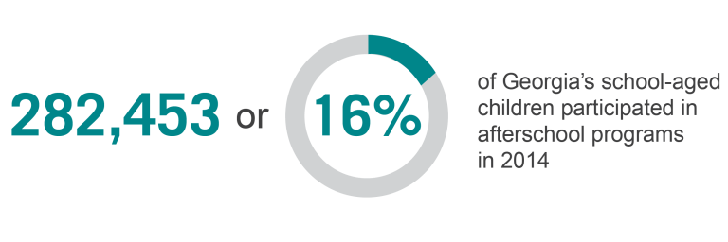
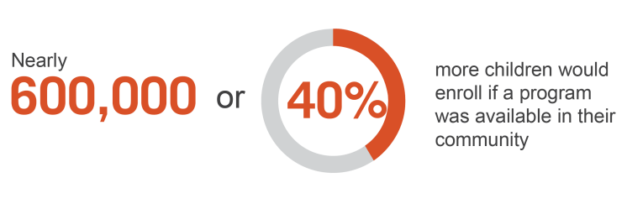
Notes:
Citation: Afterschool Alliance (2015). “America After 3PM: Georgia.” Retrieved January 18, 2018, from http://www.afterschoolalliance.org/AA3PM/

Slide 4






What the Research Says
Improving Academic Performance & Outcomes
Reducing Juvenile Crime
Reducing Drug & Alcohol Dependence
Supporting Working Families
Promoting Healthy Lifestyles
Creating the Workforce of Tomorrow
Notes:
Citation: Georgia Statewide Afterschool Network (2018). Investing in Georgia’s Youth: Why Afterschool Makes “Cents.” Retrieved August 24, 2018, from www.afterschoolga.org/roi

Slide 5

Notes:
Citation: Georgia Statewide Afterschool Network (2018). Investing in Georgia’s Youth: Why Afterschool Makes “Cents.” Retrieved August 24, 2018, from www.afterschoolga.org/roi

Slide 6




Roadmap of Benefits
This investment would allow com-
munities to leverage an estimated
$4,225,000
in additional funds from community partners and businesses to support programming
In total, this investment would provide an additional
45,409 YOUTH
with high quality programming that puts them on track for success in college,
career, and life.
Let’s start with an investment of
$25 MILLION
to increase access to high quality afterschool and summer learning programs for Georgia’s youth.
We know that regular participation in high quality afterschool and summer learning programs support Georgia’s youth by:
Reducing juvenile crime between the peak hours of
3 and 7 PM
Increasing graduation rates by reducing grade retention and increasing school day attendance
Decreasing the number of teens dependent on drugs and alcohol
Notes:
Citation: Georgia Statewide Afterschool Network (2018). Investing in Georgia’s Youth: Why Afterschool Makes “Cents.” Retrieved August 24, 2018, from www.afterschoolga.org/roi

Slide 7


By providing 45,409 of Georgia’s youth access to high quality afterschool and summer learning programs, immediate and long-term savings and benefits to taxpayers would be:
$2 MILLION
for reducing drug and alcohol dependence
$3 MILLION
for reducing grade retention
$18 MILLION
for reducing
juvenile crime
Leads to
$154 MILLION
in benefits to Georgia taxpayers for increasing access to high quality afterschool and summer learning programs.
$131 MILLION
from increased tax payments, reduced reliance on welfare systems, and reduced criminal justice costs over the years due to a reduction in crime and dropout rates
Notes:
Citation: Georgia Statewide Afterschool Network (2018). Investing in Georgia’s Youth: Why Afterschool Makes “Cents.” Retrieved August 24, 2018, from www.afterschoolga.org/roi

Slide 8
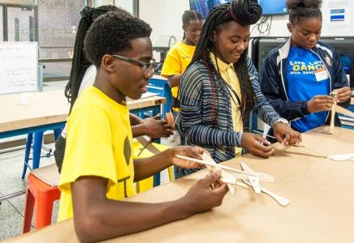
Georgia’s 21st Century Community Learning Centers Program
Notes:
Operating in all 50 states, the program was reauthorized under Title IV, Part B of the Every Student Succeeds Act (ESSA) in 2015.

Slide 9

The 21st Century Community Learning Centers (21st CCLC) Program is the only federal funding stream dedicated to before school, afterschool, and summer learning.
Notes:
Notes: Operating in all 50 states, the program was reauthorized under Title IV, Part B of the Every Student Succeeds Act (ESSA) in 2015.
In Georgia, the 21st Century Community Learning Centers is housed at the Georgia Department of Education.

Slide 10
21st CCLC in Georgia
In 2016, Georgia awarded $39,441,669
to 126 subgrants which operate
243 programs.
These 243 programs served 27,139 youth
of which approximately
89.8% were eligible for free or reduced lunch.
Notes:
Citation: Georgia Department of Education (2016). “2015-16 Executive Summary.” Retrieved January 18, 2018, from https://www.gadoe.org/School-Improvement/Federal-Programs/Documents/21st%20CCLC/FY16%2021st%20CCLC%20%20Executive%20Summary.pdf

Slide 11
Overview of 21st CCLC
Grantees must target communities with high concentrations of low-income families and students.
Programs must have a strong academic component, while still providing a broad array of additional enrichment activities.
Programs must engage with families and communities.
73% of eligible programs that applied for 21st CCLC in the 2015-16 school year were not funded.
Notes:
Citation: Georgia Department of Education (2016). “Georgia Department of Education Office of Federal Programs: 21st Century Community Learning Centers 2017-2018 (FY18) Cohort Request for Proposals.” Retrieved January 18, 2018, from http://www.gadoe.org/School-Improvement/Federal-Programs/Documents/21st%20CCLC/GaDOE%20FY18%2021st%20CCLC%20RFP.pdf

Slide 12
21st CCLC Improves Outcomes
of children who participated in 21st CCLC increased homework completion.
of children who participated in 21st CCLC improved classroom behavior.
80%
70%
73%
improved/maintained an A, B or C in their English grades.
improved/maintained an A, B, or C in their Math grades..
74%
scored developing or higher on English Language Arts Milestones.
64%
54%
scored developing or higher on Mathematics Milestones.
Notes:
Citation: Georgia Department of Education (2016). “2015-16 Executive Summary.” Retrieved January 18, 2018, from https://www.gadoe.org/School-Improvement/Federal-Programs/Documents/21st%20CCLC/FY16%2021st%20CCLC%20%20Executive%20Summary.pdf

Slide 13
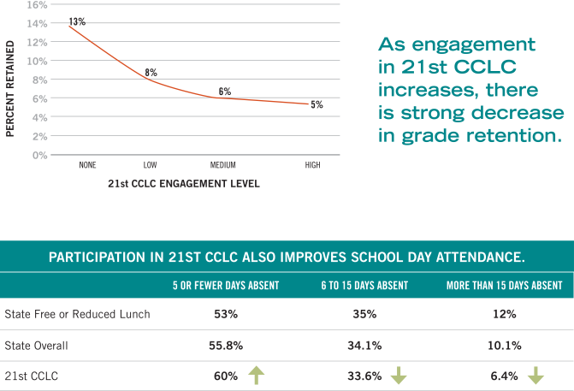
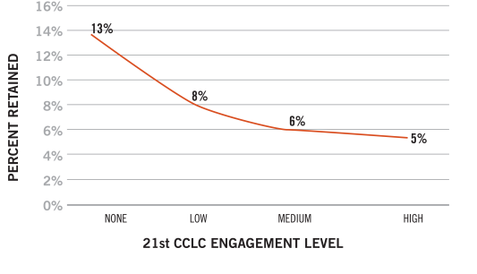
Impact on Retention Rates
As engagement in 21st CCLC increases, there is a strong decrease in retention rates.
Notes:
Citation: Georgia Statewide Afterschool Network (2018). Investing in Georgia’s Youth: Why Afterschool Makes “Cents.” Retrieved August 24, 2018, from www.afterschoolga.org/roi

Slide 14
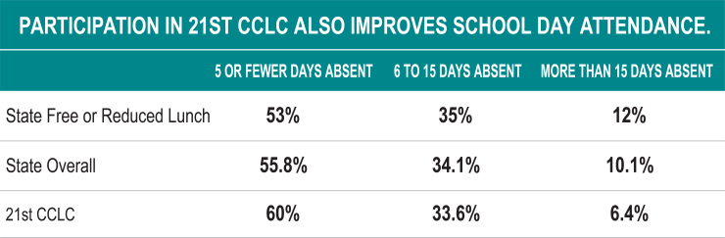
Impact on School Day Attendance
Notes:
Notes: School day attendance is higher for those regularly participating in Georgia’s 21st CCLC than the free or reduced lunch state average and the overall state average, despite 90% of 21st CCLC students being eligible for free or reduced lunch. Note that more than 15 days absent is the state’s definition of being chronically absent. For many low income students, chronic absence in kindergarten can translate into poor academic performance throughout elementary school.
Citation: Georgia Statewide Afterschool Network (2018). Investing in Georgia’s Youth: Why Afterschool Makes “Cents.” Retrieved August 24, 2018, from www.afterschoolga.org/roi

Slide 15



Let’s Connect!
[Your Name], [Title]
[Organization]
[Email Address]
[Phone Number]
[Website]

