Slide 1
Your Logo Here
WELCOME!
Investing in Georgia’s Youth
Why Afterschool Makes “Cents”

Slide 2
Why Afterschool?
HOURS OF OPPORTUNITY
80%
FORMAL CLASSROOM LEARNING
20%
Notes:
Notes: With children spending more than 80% of their waking hours outside of formal classroom learning, afterschool and summer learning programs are an essential strategy in improving outcomes for Georgia’s youth, decreasing the achievement gap, and supporting Georgia’s economy. In fact, afterschool programs, such as Georgia’s 21st Century Community Learning Centers, often provide more than 45 additional school days for a child to learn and grow.
Citations: Afterschool Alliance (2018). “This is Afterschool in Georgia.” Retrieved April 26, 2018, from http://www.afterschoolalliance.org/documents/GA-afterschool-facts.pdf
Analysis of data provided by the Georgia Department of Education (2016).

Slide 3
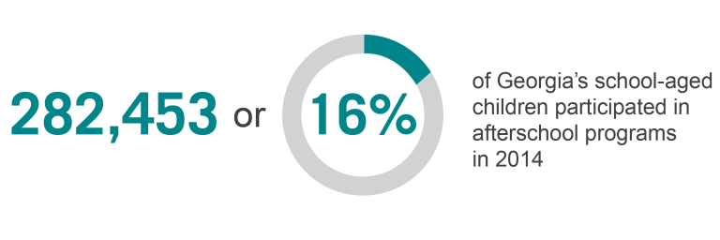
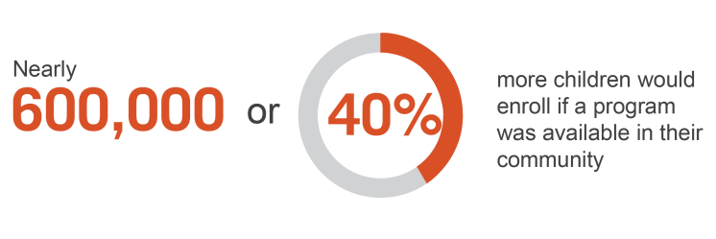
Notes:
Citation: Afterschool Alliance (2015). “America After 3PM: Georgia.” Retrieved January 18, 2018, from http://www.afterschoolalliance.org/AA3PM/

Slide 4
What the Research Says
Improving Academic Performance & Outcomes
Reducing Juvenile Crime
Reducing Drug & Alcohol Dependence
Supporting Working Families
Promoting Healthy Lifestyles
Creating the Workforce of Tomorrow
Notes:
Citation: Georgia Statewide Afterschool Network (2018). Investing in Georgia’s Youth: Why Afterschool Makes “Cents.” Retrieved August 24, 2018, from www.afterschoolga.org/roi

Slide 5
Notes:
Citation: Georgia Statewide Afterschool Network (2018). Investing in Georgia’s Youth: Why Afterschool Makes “Cents.” Retrieved August 24, 2018, from www.afterschoolga.org/roi

Slide 6
Roadmap of Benefits
This investment would allow com-
munities to leverage an estimated
$4,225,000
in additional funds from community partners and businesses to support programming
In total, this investment would provide an additional
45,409 YOUTH
with high quality programming that puts them on track for success in college,
career, and life.
Let’s start with an investment of
$25 MILLION
to increase access to high quality afterschool and summer learning programs for Georgia’s youth.
We know that regular participation in high quality afterschool and summer learning programs support Georgia’s youth by:
Reducing juvenile crime between the peak hours of
3 and 7 PM
Increasing graduation rates by reducing grade retention and increasing school day attendance
Decreasing the number of teens dependent on drugs and alcohol
Notes:
Citation: Georgia Statewide Afterschool Network (2018). Investing in Georgia’s Youth: Why Afterschool Makes “Cents.” Retrieved August 24, 2018, from www.afterschoolga.org/roi

Slide 7
By providing 45,409 of Georgia’s youth access to high quality afterschool and summer learning programs, immediate and long-term savings and benefits to taxpayers would be:
$2 MILLION
for reducing drug and alcohol dependence
$3 MILLION
for reducing grade retention
$18 MILLION
for reducing
juvenile crime
Leads to
$154 MILLION
in benefits to Georgia taxpayers for increasing access to high quality afterschool and summer learning programs.
$131 MILLION
from increased tax payments, reduced reliance on welfare systems, and reduced criminal justice costs over the years due to a reduction in crime and dropout rates
Notes:
Citation: Georgia Statewide Afterschool Network (2018). Investing in Georgia’s Youth: Why Afterschool Makes “Cents.” Retrieved August 24, 2018, from www.afterschoolga.org/roi

Slide 8
The Afterschool Care Program
Notes:
Notes: Housed at the Georgia Division of Family and Children Services (DFCS), the Afterschool Care Program provides quality out-of-school time youth development programs and services to youth between the ages of 5 and 17. The Afterschool Care Program is funded through Georgia’s Temporary Assistance for Needy Families (TANF) dollars, a federal program designed to help needy families achieve self-sufficiency.

Slide 9
Overview of the Afterschool Care Program
Programs target youth from low to moderate income communities, the foster care system, or congregate care settings.
Programs are required to provide a variety of activities, including Science, Technology, Engineering, Arts and Math (STEAM) and health and well-being activities.
The Afterschool Care Program serves 72,191 youth at 278 programs.
Notes:
Citation: Georgia Division of Family and Children Services (2018).

Slide 10
All programs must meet a mandatory match requirement based on the amount of funding requested.
For every $1 of funding, an additional $2.47 is leveraged through local partnerships to provide high quality out-of-school time programming.
For every $1 of funding, an additional $2.47 is leveraged through local partnerships to provide high quality out-of-school time programming.
Notes:
Citation: Georgia Division of Family and Children Services (2018).

Slide 11
Let’s Connect!
[Your Name], [Title]
[Organization]
[Email Address]
[Phone Number]
[Website]

